Slide 1

GOVERMENT ENGINEERING COLLEGE
Subject: computer vision
Topic- Face Recognition Based Attendance Monitoring System
Prepared by:- Parmar Nikita
Submitted to:-Daval khem

Slide 2
Contents
1.Abstract
2. Introduction
3.Literature Survey
4.Implementation
5.dataset
6. Result
7. References

Slide 3
Abstract
The management of the attendance can be a great burden on the teachers if it is done by hand. To resolve this problem, smart and auto attendance management system is being utilized. By utilizing this framework, the problem of proxies and students being marked present even though they are not physically present can easily be solved. This system marks the attendance using live video stream. The frames are extracted from video using OpenCV.

Slide 4
Introduction
Human face plays an important role in our day to day life mostly for identification of a person. Face recognition is a part of biometric identification that extracts the facial features of a face, and then stores it as a unique face print to uniquely recognize a person. Biometric face recognition technology has gained the attention of many researchers because of its wide application. Face recognition technology is better than other biometric based recognition techniques like finger-print, palm-print, iris because of its non-contact process. Recognition techniques using face recognition can also recognize a person from a distance, without any contact or interaction with person. The face recognition techniques are currently implemented in social media websites like Facebook, at the airports, railway stations.

Slide 5
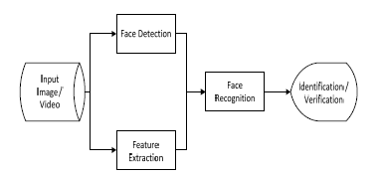
Block Diagram of a general face recognition system

Slide 6
Face Recognition model

Slide 7
Literature Survey
Author | Algorithm | Problem | Summary
Jomon | Eigenfaces | student once marked present is not done | MATLAB implement face recognition
Syen navaz | PCA, ANN | Low accuracy with the big size of images to train with PCA | Using PCA to train and reduce dimensionality and ANN to classify input data and find the pattern
Kar, Nirmalya | PCA | Repeat image capturing | Using Eigenvector and Eigenvalue for face recognition

Slide 8
Implementation
import tkinter as tk
from tkinter import ttk
from tkinter import messagebox as mess
import tkinter.simpledialog as tsd
import cv2,os
import csv
import numpy as np
from PIL import Image
import pandas as pd
import datetime
import time
############################################# FUNCTIONS ################################################
def assure_path_exists(path):
dir = os.path.dirname(path)
if not os.path.exists(dir):
os.makedirs(dir)

Slide 9
Implementation (con)
def tick():
time_string = time.strftime('%H:%M:%S')
clock.config(text=time_string)
clock.after(200,tick)
###################################################################################
def contact():
mess._show(title='Contact us', message="Please contact us on : 'shubhamkumar8180323@gmail.com' ")
###################################################################################
def check_haarcascadefile():
exists = os.path.isfile("haarcascade_frontalface_default.xml")
if exists:
pass
else:
mess._show(title='Some file missing', message='Please contact us for help')
window.destroy()

Slide 10
Implementation (con)
def save_pass():
assure_path_exists("TrainingImageLabel/")
exists1 = os.path.isfile("TrainingImageLabel\psd.txt")
if exists1:
tf = open("TrainingImageLabel\psd.txt", "r")
key = tf.read()
else:
master.destroy()
new_pas = tsd.askstring('Old Password not found', 'Please enter a new password below', show='*')
if new_pas == None:
mess._show(title='No Password Entered', message='Password not set!! Please try again')
else:
tf = open("TrainingImageLabel\psd.txt", "w")
tf.write(new_pas)
mess._show(title='Password Registered', message='New password was registered successfully!!')
return

Slide 11
Implementation (con)
op = (old.get())
newp= (new.get())
nnewp = (nnew.get())
if (op == key):
if(newp == nnewp):
txf = open("TrainingImageLabel\psd.txt", "w")
txf.write(newp)
else:
mess._show(title='Error', message='Confirm new password again!!!')
return
else:
mess._show(title='Wrong Password', message='Please enter correct old password.')
return
mess._show(title='Password Changed', message='Password changed successfully!!')
master.destroy()

Slide 12
Implementation (con)
def change_pass():
global master
master = tk.Tk()
master.geometry("400x160")
master.resizable(False,False)
master.title("Change Password")
master.configure(background="white")
lbl4 = tk.Label(master,text=' Enter Old Password',bg='white',font=('comic', 12, ' bold '))
lbl4.place(x=10,y=10)
global old
old=tk.Entry(master,width=25 ,fg="black",relief='solid',font=('comic', 12, ' bold '),show='*')
old.place(x=180,y=10)
lbl5 = tk.Label(master, text=' Enter New Password', bg='white', font=('comic', 12, ' bold '))
lbl5.place(x=10, y=45)
global new
new = tk.Entry(master, width=25, fg="black",relief='solid', font=('comic', 12, ' bold '),show='*')
new.place(x=180, y=45)
lbl6 = tk.Label(master, text='Confirm New Password', bg='white', font=('comic', 12, ' bold '))
lbl6.place(x=10, y=80)

Slide 13
Implementation (con)
global nnew
nnew = tk.Entry(master, width=25, fg="black", relief='solid',font=('comic', 12, ' bold '),show='*')
nnew.place(x=180, y=80)
cancel=tk.Button(master,text="Cancel", command=master.destroy ,fg="black" ,bg="red" ,height=1,width=25 , activebackground = "white" ,font=('comic', 10, ' bold '))
cancel.place(x=200, y=120)
save1 = tk.Button(master, text="Save", command=save_pass, fg="black", bg="#00fcca", height = 1,width=25, activebackground="white", font=('comic', 10, ' bold '))
save1.place(x=10, y=120)
master.mainloop()
#####################################################################################
def psw():
assure_path_exists("TrainingImageLabel/")
exists1 = os.path.isfile("TrainingImageLabel\psd.txt")
if exists1:
tf = open("TrainingImageLabel\psd.txt", "r")
key = tf.read()
else:
new_pas = tsd.askstring('Old Password not found', 'Please enter a new password below', show='*')
if new_pas == None:
mess._show(title='No Password Entered', message='Password not set!! Please try again')
else:

Slide 14
Implementation (con)
ef clear():
txt.delete(0, 'end')
res = "1)Take Images >>> 2)Save Profile"
message1.configure(text=res)
def clear2():
txt2.delete(0, 'end')
res = "1)Take Images >>> 2)Save Profile"
message1.configure(text=res)
#######################################################################################
def TakeImages():
check_haarcascadefile()
columns = ['SERIAL NO.', '', 'ID', '', 'NAME']
assure_path_exists("StudentDetails/")
assure_path_exists("TrainingImage/")
serial = 0
exists = os.path.isfile("StudentDetails\StudentDetails.csv")

Slide 15
Implementation (con)
if exists:
with open("StudentDetails\StudentDetails.csv", 'r') as csvFile1:
reader1 = csv.reader(csvFile1)
for l in reader1:
serial = serial + 1
serial = (serial // 2)
csvFile1.close()
else:
with open("StudentDetails\StudentDetails.csv", 'a+') as csvFile1:
writer = csv.writer(csvFile1)
writer.writerow(columns)
serial = 1
csvFile1.close()
Id = (txt.get())
name = (txt2.get())
if ((name.isalpha()) or (' ' in name)):
cam = cv2.VideoCapture(0)
harcascadePath = "haarcascade_frontalface_default.xml"
detector = cv2.CascadeClassifier(harcascadePath)
sampleNum = 0
while (True):
Continue………………………………………….

Slide 16
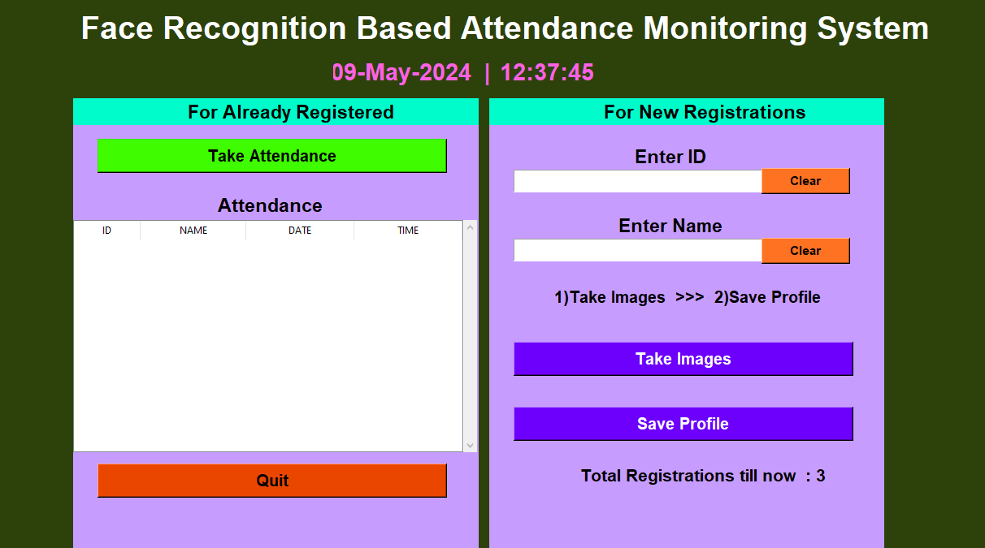
output

Slide 17
Conclusion
This system aims to build an effective class attendance system using face recognition techniques. The proposed system will be able to mark the attendance via face Id. It will detect faces via webcam and then recognize the faces. After recognition, it will mark the attendance of the recognized student and update the attendance record.

Slide 18
Thank you

